Slide 1

Smart farming system

Slide 2
TEAM MEMBERS
KAREEM CRUM
Military
Student
Son
Grandson
Brother
Uncle and
Boyfriend
STEPHANIE PEREA
Sandia National Laboratories Retiree
Mother of 3 beautiful Children
Grandmother of 8 wonderful grandchildren
Big Sister
Care-taker of disabled brother for last 25 years
Animal Lover & Keeper of 2 dogs and 1 kitten

Slide 3
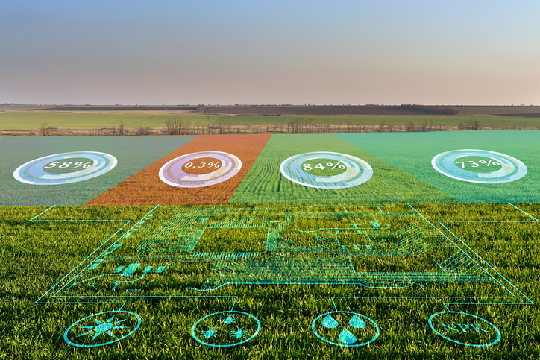
What is a Smart Farming System (SFS)
An SFS provides an array of
resources for real-time
environmental stats
& physical security

Slide 4
PROJECT PROPOSAL
Environmentally Friendly Pest Control
.
Technology assisted yield gains
Intelligent decision
Tools
Weather
Station
Enhanced crop development tool

Slide 5
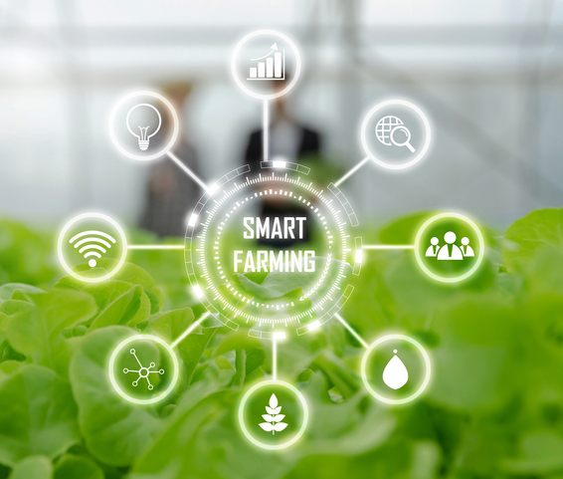
IoT Precision Agriculture Intelligent Decision Making

Slide 6
The purpose
of this project came about because of my
real-life experiences during
New Mexico’s
1st hemp farming season in 2019

Slide 7
Hemp legalization occurred under the 2019 Farm Bill which was passed on December 20, 2018; however, an approved USDA Domestic Hemp Production Program was not established until March 22, 2021.
Since farmers had no established guidance from the USDA; the first 2 hemp farming seasons were negatively impacted.
One of the hardest hit aspects of hemp farming was in pest control. This was because there were no approved pesticides to help keep hemp crops free from disease and pests.
With more farms going organic, the pesticide problem is still needing to be addressed.

Slide 8
The IoT Bootcamp introduced us to a ultrasonic sensor which is proving to be a great solution to the pest problem and with that I turn it over to Kareem to discuss the capabilities of the ultrasonic sensor which is an important aspect of the Smart Farming System.

Slide 9
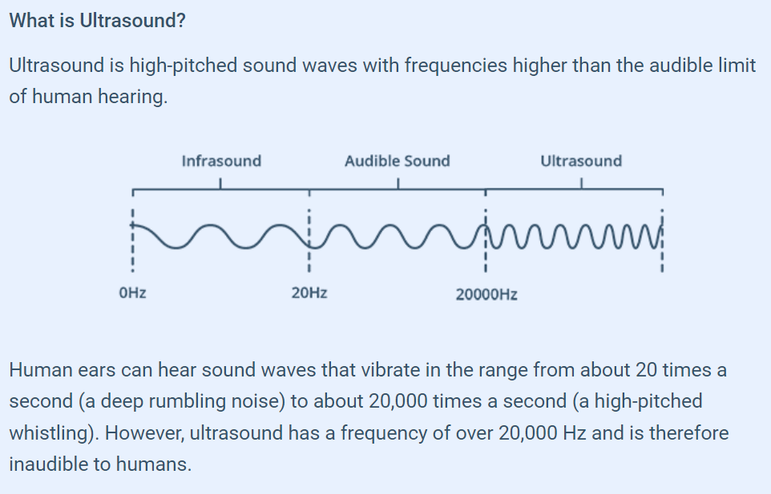

Slide 10
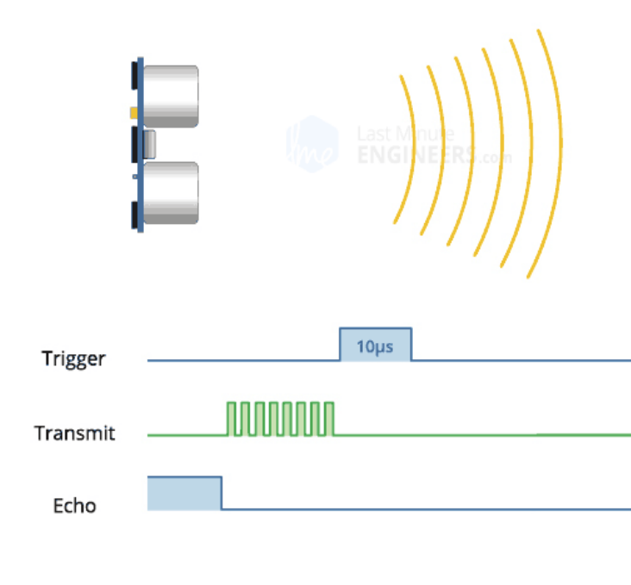
Eight ultrasonic pulses travel through the air away from the transmitter

Slide 11
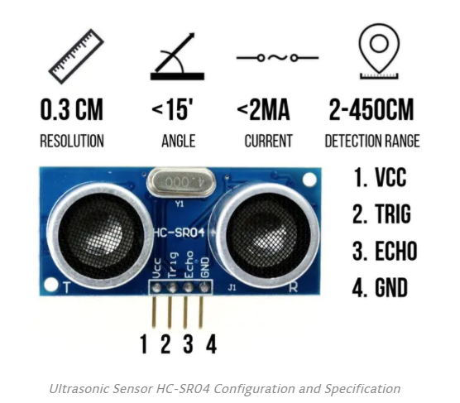
ULTRASONIC SENSOR
Environmentally Friendly Cost Effective
Pest Control System
Equipped with BaT-mAn Powers it provides a 40 kHz Frequency which is well within the variance to deter pests
2 Ultrasonic Transducers trigger and echo- providing 8 Ultrasonic Pulses Every 10 Microseconds with a reaching
Distance of up to 26 feet
Wireless Low Power component - Easily Interfaced with a Battery & Solar Panel
Maximum direct line sight by a slow continuous back and forth 180 degree sweep for ample field coverage
Integrated remote cloud computing using WiFi and Bluetooth capabilities

Slide 12
Another problematic factor hemp farmers faced and still dealing with are licensing requirements.
One of main issues is physical security and safe keeping of hemp because it contains Delta 9 tetrahydrocannabinol (THC) which is listed under Schedule I by US federal law^{[16]} under the Controlled Substances Act.
Because of the THC content theft is problematic not only because of the loss in yield but also because of the farmer’s legal responsibility to maintain control of all THC they produce.
IoT again has come to the hemp farmer’s rescue. The same ultrasonic component used to deter pests of 8 plus legs also serves as a security system to catch large 2 legged pests know as thieves. I turn it over to Kareem to discuss how the ultrasonic sensor is also serving as a security system.

Slide 13
ULTRASONIC SENSOR
Cost Effective, reduces carbon footprint as a Low Power, Easily Interfaced Security System
2 Ultrasonic Transducers - 8 Ultrasonic Pulses Every 10 Microseconds
Distance sensor for up to 13 feet
Low Power component - - Battery & Solar Panel
powered
Maximum direct line sight slowly emitting pulses while slowly turning 180 to the left and right continuously
Real-time Text Notification when system detects intruder

Slide 14
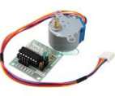
ROHS28BYJ-48 Step Motor
5VDC
Class B insulation
Internal wiring to sustain temperatures of up to 130 degrees Celsius
WithaAmbient temperature of 40 Celsius, the stepper motor has a temperature rise allowance of 90 Celsius.
Stepper motors can run continuously at these temperatures.

Slide 15
Another factor farmers dealt with and still are dealing with is controlling hemp pollination. Pollination became problematic because when hemp is pollinated, it begins the process of seed propagation and in turn decreases trichome production.
Trichomes are the mechanism by which hemp produces cannabinoids, such as cannabidiol (CBD)
Majority of New Mexican farmers grew high CBD hemp strains to
produce, manufacture and sell high quality CBD hemp oil not seeds.

Slide 16
A solution to the pollination problem is to monitor the environment with a great IoT device called a Grove Dust Sensor which is a particulate sensor.
This sensor has the capabilities to detect particles as small as 1um in size. One great thing about cannabis pollen is it measures approximately 25um which is rather large especially when wet. Thus, it is not difficult to detect during the pollination season. The pollination season begins about 4 to 5 weeks after females’ flower.
When heavy particulate detection occurs during pollination season, an alert will be sent to the farmer to seek out all the male plants and all hermaphrodites and remove them from the crop.
It is important to note that nearly 100 percent of seed planted in New Mexico is feminized seed which is guaranteed to produce approximately 99% female plants per pound. It is also important to keep in mind that some female plants are hermaphrodites and can also pollinate other females.
I will turn it over to Kareem to explain how the pollen detection works in the Smart Farm System

Slide 17
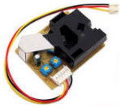
Pollen Detection System
Monitors pollen for optimal trichome and cannabinoid yield
Pollination control to prevent seed propagation
Geo mapping to rapidly eliminate male plants
Connected to a solar power unit for 24/7 wireless rural monitoring
Cloud Computing Capabilities - remotely connectivity via WiFi and Blue tooth
-

Slide 18
Weather proved to be a much larger challenge than usual for hemp farmers During the grow season, the lack of proper soil moisture management caused many hemp plants to fall into a stressed state. When hemp is in a stressed state it causes a spike in tetrahydrocannabinol (THC) production. This unfortunately, caused many hemp crops to surpass the 0.3% THC threshold which inevitably led to the destruction of many New Mexico hemp crops which hurt many farmers financially. During the harvest season, farmers were unaware as to how sensitive cannabis was to frost and a significant amount of plants were lost which reduced the amount of biomass for a which impacted the return of investment. During the drying and curing segment of harvest, farmers were not aware hemp needs to be properly dried down to a 20% moisture level or less. If hemp is not properly dried and it is highly prone to fungus, mold and other macro-organisms rendering it useless for oil production creating a financial burden for proper disposal of the compromised biomass.

Slide 19
The Smart Farming System houses a weather station.
The weather station is comprised of 2 components and a cloud- based website.
The first component is the BME280 which is a temperature, humidity and pressure sensor.
The second component is a monochrome I2C OLED Display unit with a 128 x 64 resolution dot matrix panel.
The weather data can be accessed from anywhere in the world via Adafruit.io which provides real-time data on the status of the crop’s environment.

Slide 20
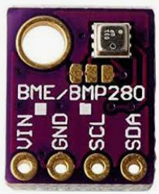
BME280
This precision sensor can measure relative humidity from 0 to 100% with ±3% accuracy, barometric pressure from 300Pa to 1100 hPa with ±1 hPa absolute accuracy, and temperature from -40°C to 85°C with ±1.0°C accuracy.
The pressure measurements are so precise (low altitude noise of 0.25m), you can even use it as an altimeter with ±1 meter accuracy.
bme280 sensor specifications

Slide 21
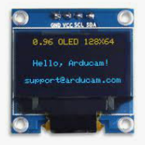
OLED Display
Features
Diagonal Screen Size：0.96"
Number of Pixels：128 x 64
Color Depth：Monochrome
Dimension：27.8 x27.3x 4.3 mm
Working Voltage: 3.3~ 5V DC
Power: 0.06W Max
Viewing Angle: >160 Degree
Duty：1/32
Brightness ( cd/m2)：150 (Typ) @ 5V
Interface： I2C

Slide 22
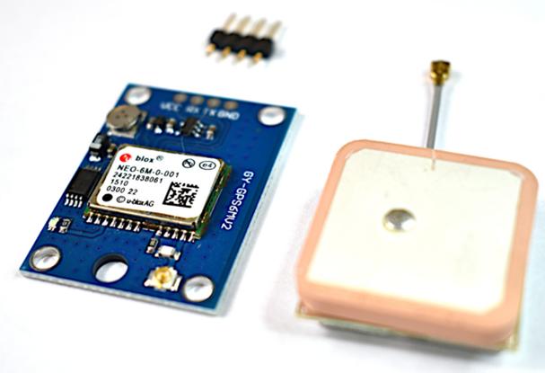
NEO-6M GPS Module
Module Description:
Power Supply: 3V-5V
EEPROM
LED Indicator
Backup battery
Baud Rate: 9600
Mounting Holes: 3mm
Module Dimensions: 23mm x 30mm
Antenna Dimensions: 25mm x 25mm
Antenna Cable Length: 50mm
Arduino UART Compatible

Slide 23
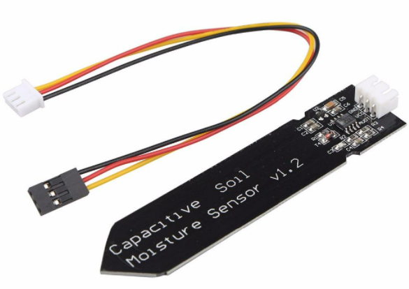
Soil Sensor
This soil moisture sensor module uses capacitance rather than resistance to determine the water content of soil
The capacitive probe improves that situation because the sensor metal inserted into the soil can be covered in solder resist to minimize corrosion and electrical current is not flowing through the soil to induce electrolysis.
The module uses a TL555I CMOS timer to create a 1.5MHz clock
A peak voltage detector converts the waveform from the TL555I into a DC voltage that can be read by the ADC input of a microcontroller.
When the probe is exposed to moisture, it affects the capacitance of the circuit which in turn affects the peak amplitude of the signal and therefore the DC voltage output that is being monitored by the MCU. Higher moisture = lower DC voltage output.

Slide 24
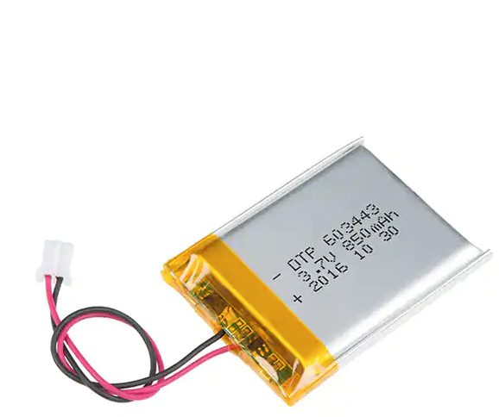
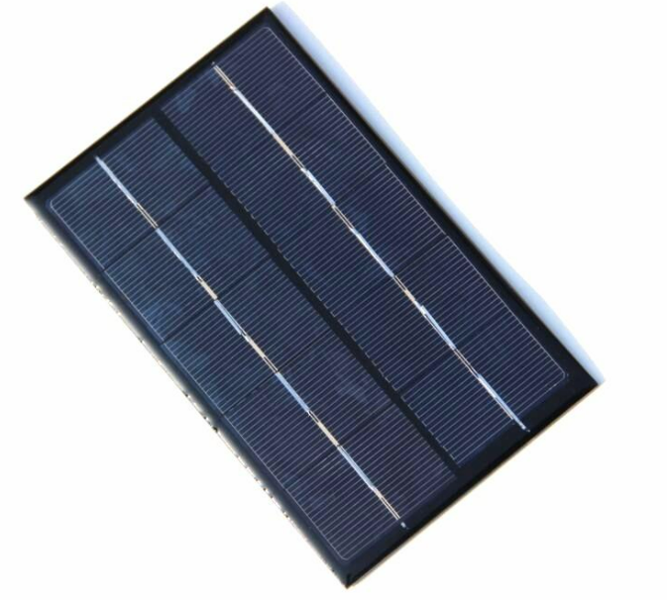
Solar Cell & Battery
Type：Polymer Li-ion Rechargeable Battery Model：DTP603443 Specification：3.7V/850mAh
1X 6V 1W 110x60mm Micro Mini Power Small Polycrystalline Solar Cell Panel Module

Slide 25
TECHNOLOGY
ADAFRUIT.IO DASH BOARD
LASER CUTTER
ADOBE ILLUSTRATOR
UNIT STAND

Slide 26
CONCEPTUAL DRAWINGS

Slide 27
MANUAL CAPABILITIES
CELLULAR ACCESS
MOBILE APP
BLUE TOOTH
WIFI
EX: BUTTON ON ADAFRUIT.IO

Slide 28
FLOWCHARTS

Slide 29
FRITZING DIAGRAM

Slide 30
SCHEMATIC

Slide 31
SOFTWARE
ADAFRUIT.IO
ADOBE ILLUSTRATOR
STL FILES

Slide 32
TASK LIST

Slide 33
TIME TABLE

Slide 34
PROTOTYPE PRODUCT PHOTOGRAPHS

Slide 35
COAD ROADMAP
BROKEN INTO FUNCTIONAL AREAS
LOGIC

Slide 36
GITHUB OVERVIEW
PROJECT ROADMAP
PROJECT MANAGEMENT TOOLS

Slide 37
PROJECT EXPECTATIONS
MEETS MINIMUM REQUIREMENTS
OPERABLE
ADDITIONAL FEATURES IMPLEMENTED
OPERABLE

Slide 38
DATA
PUBLICALLY PUBLISHED
HACKSTER.IO

Slide 39
VIDEO DEMO
ASPECTS OF PRODUCT FUNCTIONALITY
DEMONSTRATION OF WORKING PROTOTYPE
FILM QUALITY HIGH
PHOTO QUALITY HIGH
ZOOM TO HIGHLIGHT COMPONENTS
NARRIATION AND SUBTITLES USED TO EMPHASIZE POINTS

Slide 40
Developmental challenges
Problem solving
Teaming solutions

Slide 41
Final project summary

Slide 42
Future goals for project
Camera
Random Frequency output with 2 Piezoelectric Elements

Slide 43


Stephanie Perea sperea10@cnm.edu

